Slide 1
2021/09/15

Slide 2
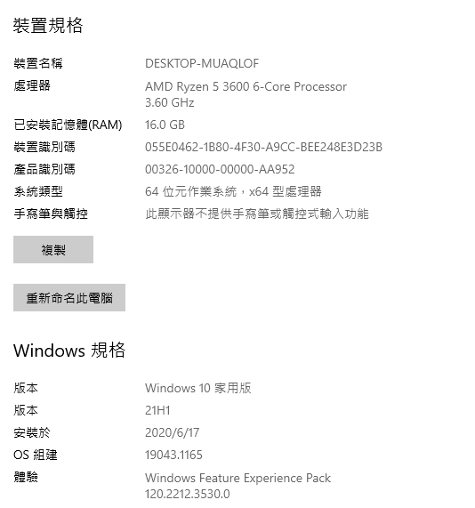

Slide 3
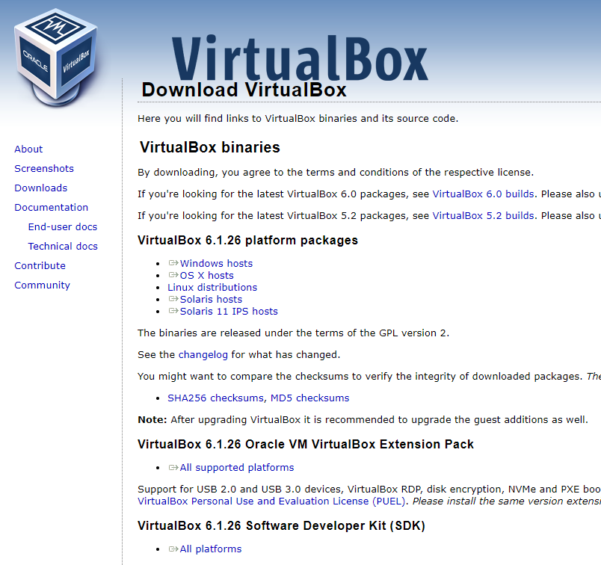

Slide 4
